Slide 1


Slide 2
SHOPAI: AI-based Online Shopping with Product Recommendations

Slide 3
INTRODUCTION OF PROJECT
Shop-AI, an innovative website dedicated to women's fashion, offers a vast array of fashion products.
This platform boasts a user-friendly interface, providing numerous functionalities tailored for seamless user experiences. Such as:
  Guest Checkout: Enables hassle-free purchases for both registered and non-registered users.
  Advanced Search and Filters: Facilitates easy navigation and product discovery through efficient search and filter options.
  Intuitive Navigation: Ensures smooth transition between pages, enhancing user experience.

Slide 4
Personalized Recommendation System:
Shop-AI's standout feature lies in its personalized recommendation system. By analyzing registered users' interactions with various products, the website discerns user preferences. Leveraging this information, the platform intelligently suggests products on the home page that align with a user's past interactions and preferences.
Data Source:
The products available on Shop-AI are sourced from the Ecommerce Fashion Dataset from the Kaggle website.

Slide 5
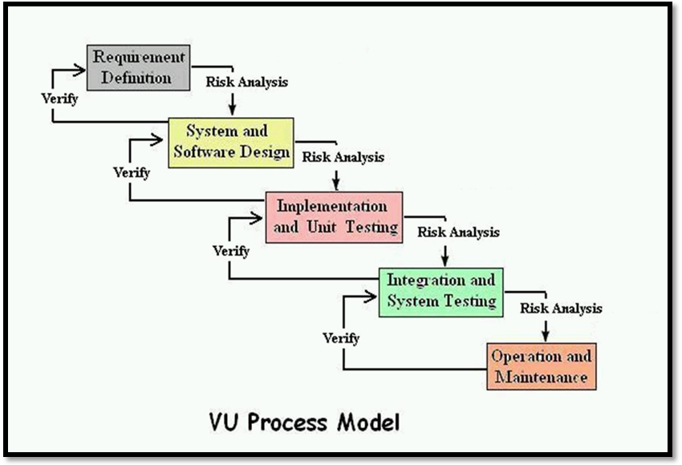
DIAGRAM OF VU PROCESS-MODEL:

Slide 6
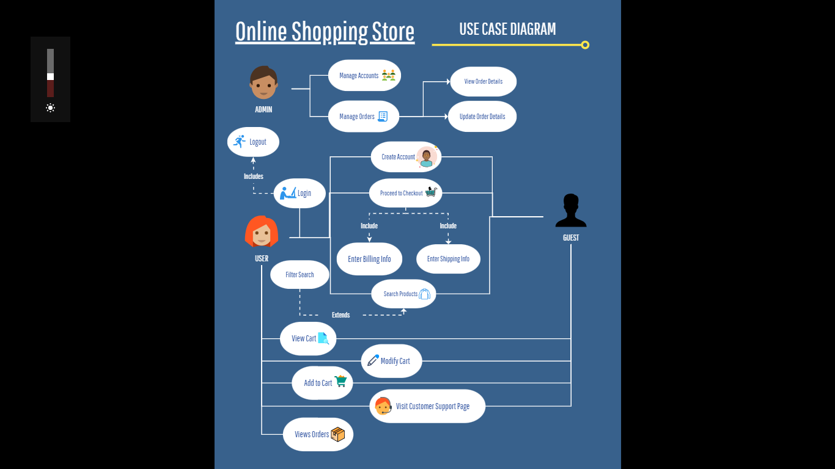
Use Case Diagram:

Slide 7
Business Rules Catalog:
  User Account Creation and Management
  Products Searching and Filtering
  Adding Products to Cart, Cart Management and Checkout Process
  Order Management and Tracking
  Customer Support – To provide users with contact details like email and phone number etc.
  Product Recommendations based on Previous User - Interactions
  Guest Checkout – To allow user to checkout without having to register an account.

Slide 8
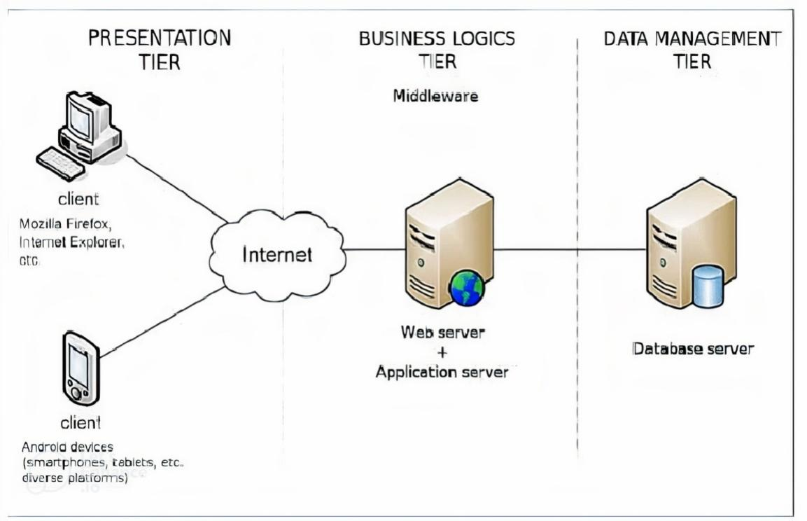
Architectural Design:

Slide 9
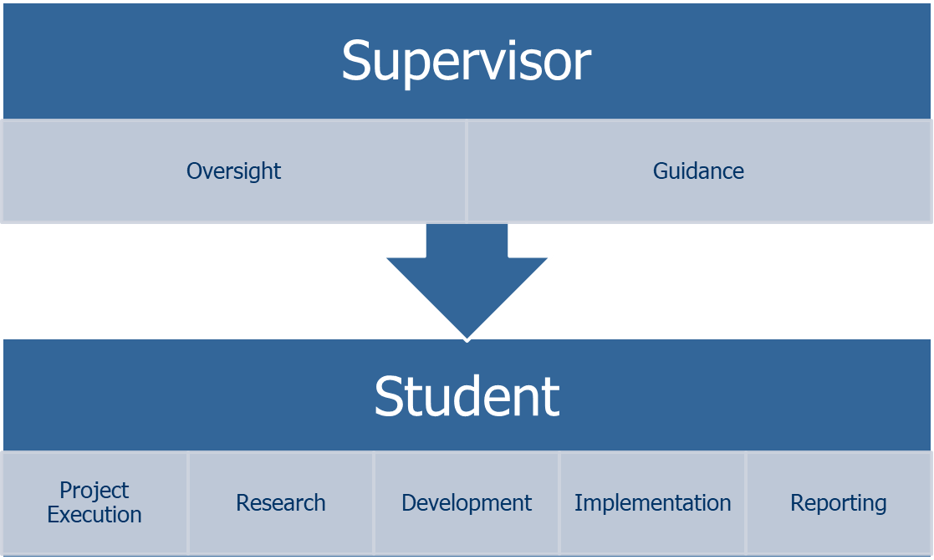
Team Structure:

Slide 10
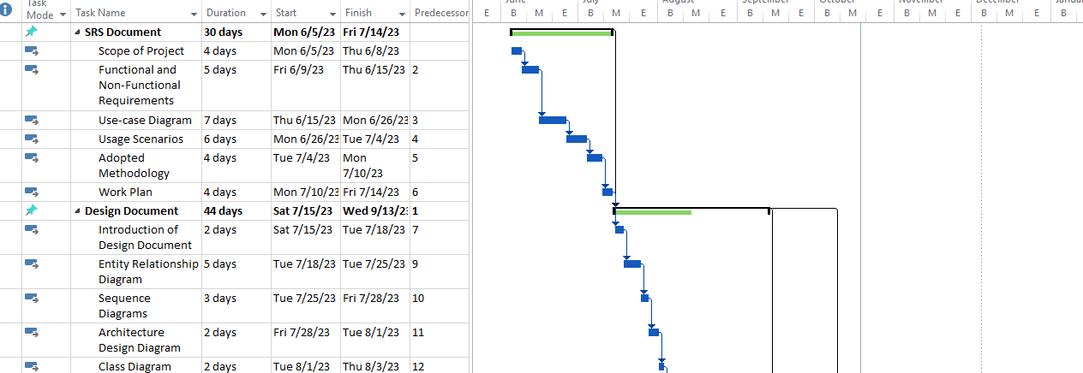
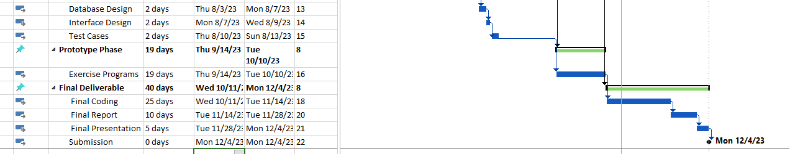
Project Schedule:

Slide 11
Sequence
Diagrams

Slide 12
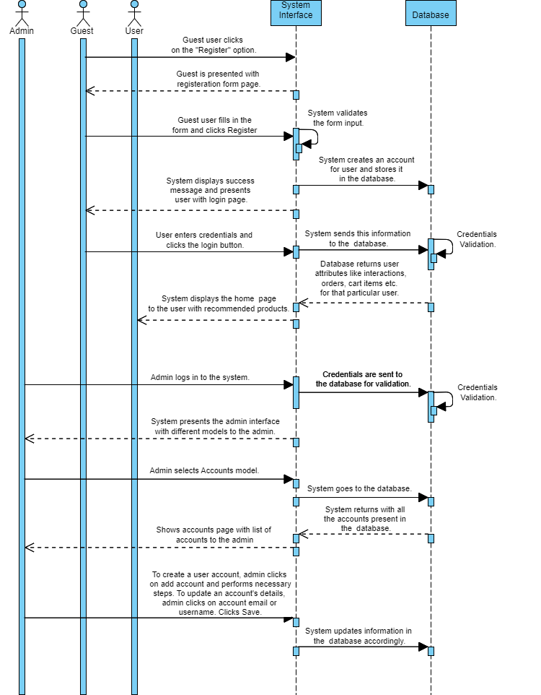
  User Account Creation and Management:

Slide 13
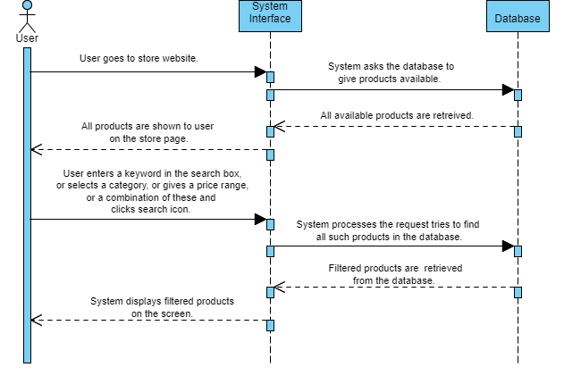
  PRODUCT CATALOG INTERACTION:

Slide 14
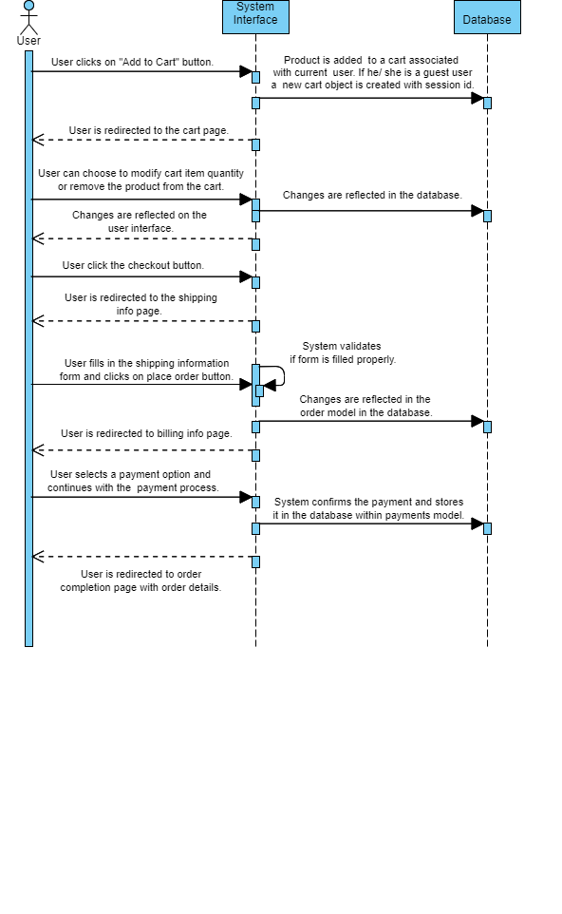
  CART MANAGEMENT & CHECKOUT PROCESS:

Slide 15
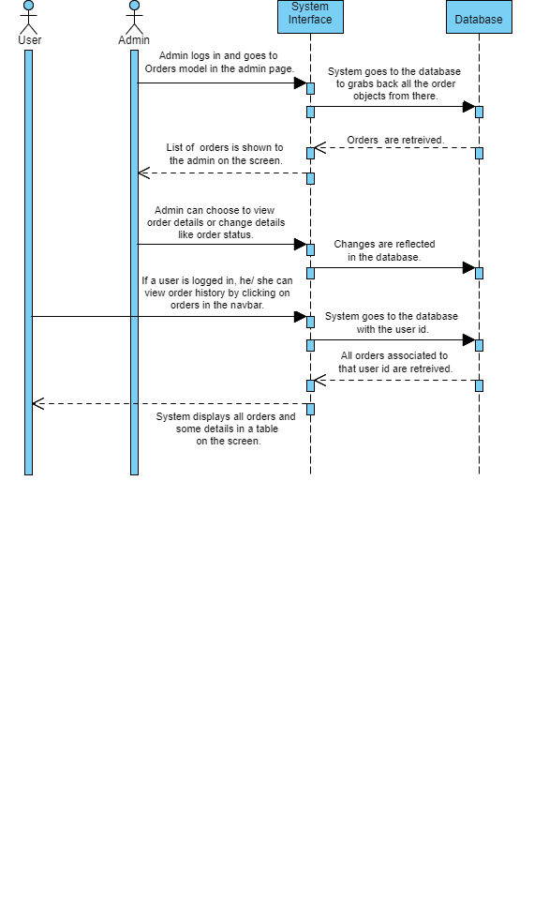
  ORDER MANAGEMENT:

Slide 16
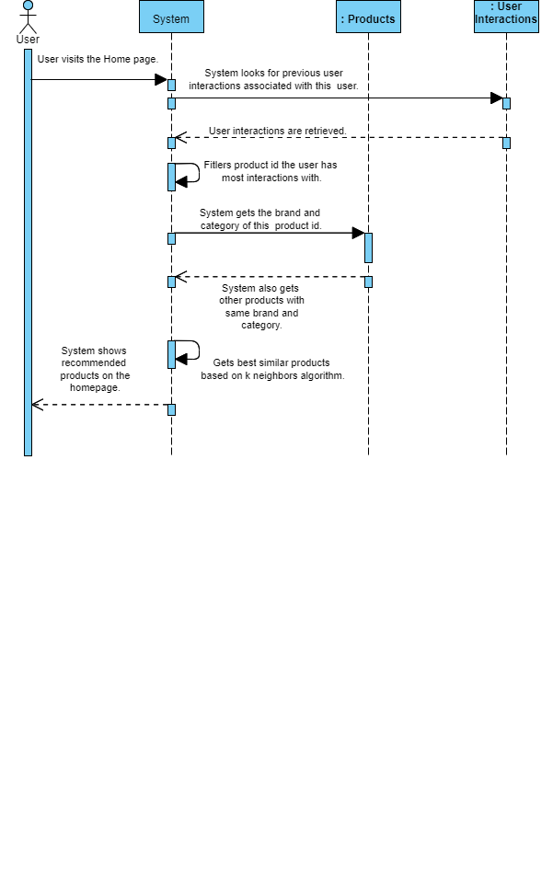
  PRODUCT RECOMMENDATIONS:

Slide 17
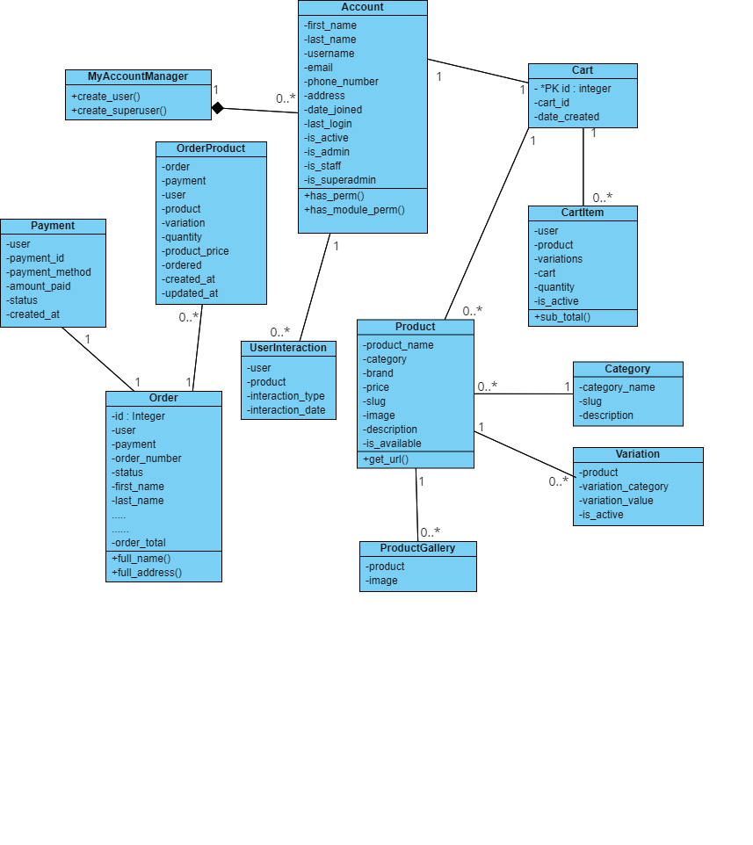
Logical Model / Class Diagram:

Slide 18
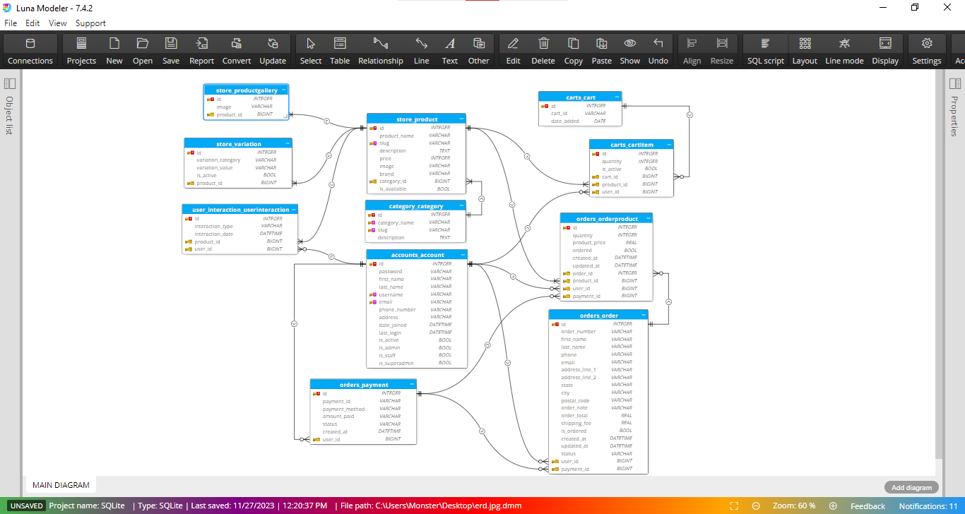
ENTITY RELATIONSHIP DIAGRAM:

Slide 19
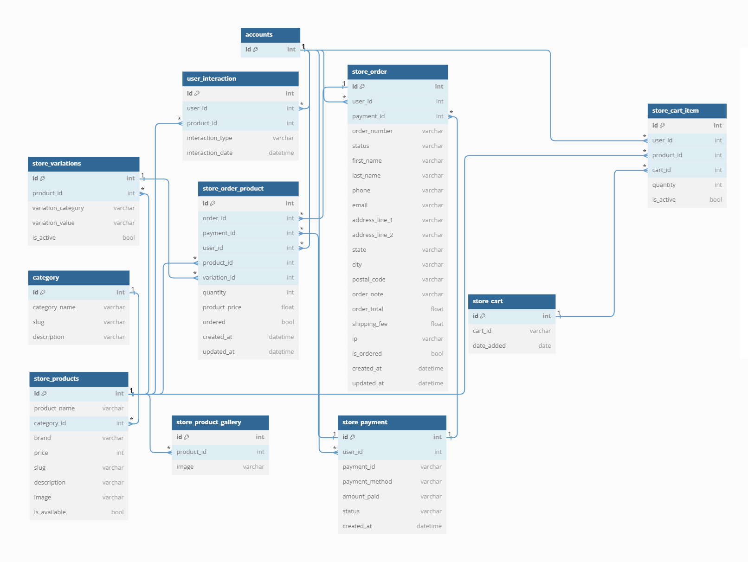
Database Diagram:

Slide 20
Graphical
User-Interfaces

Slide 21
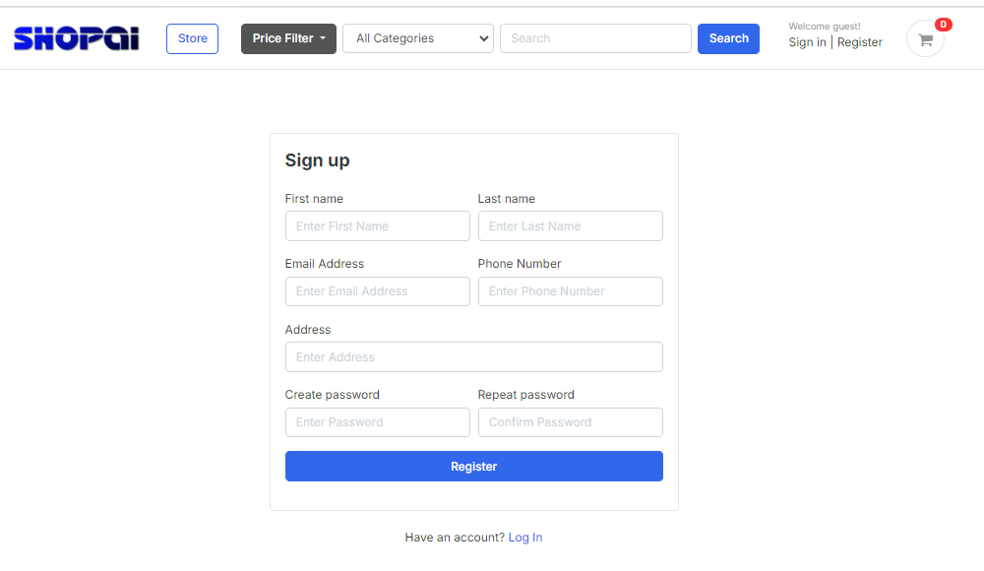
User Registration Interface:

Slide 22
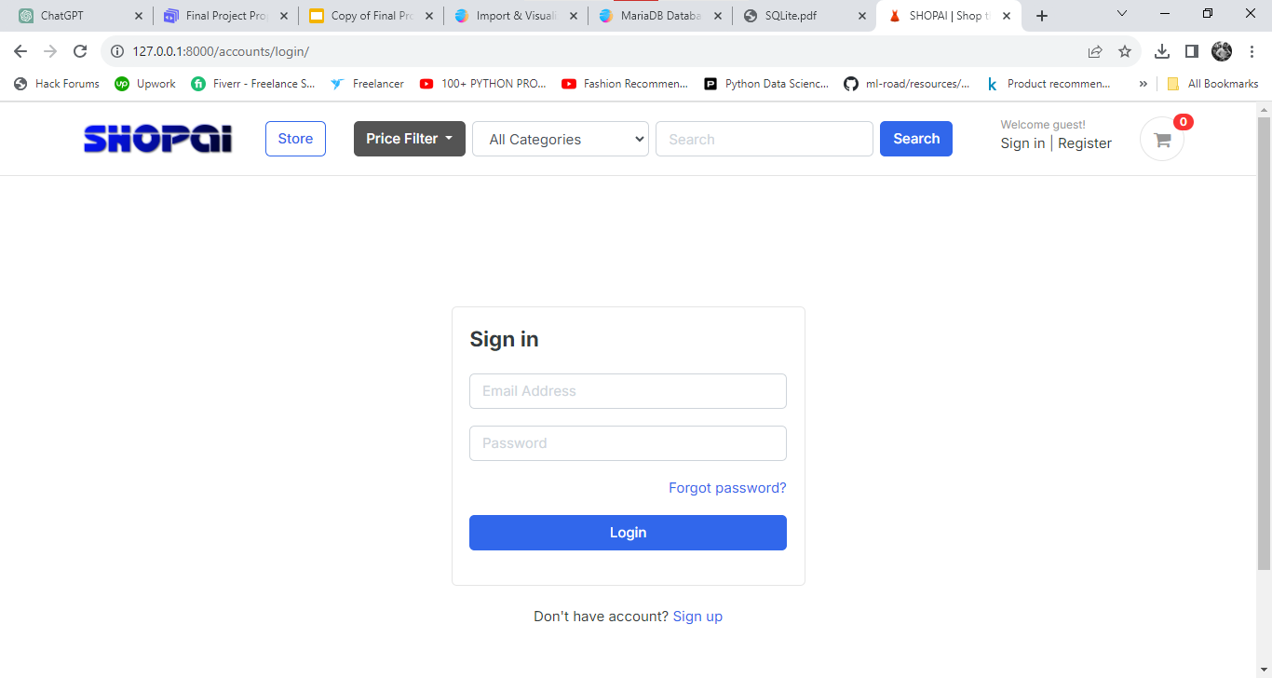
Login Interface:

Slide 23
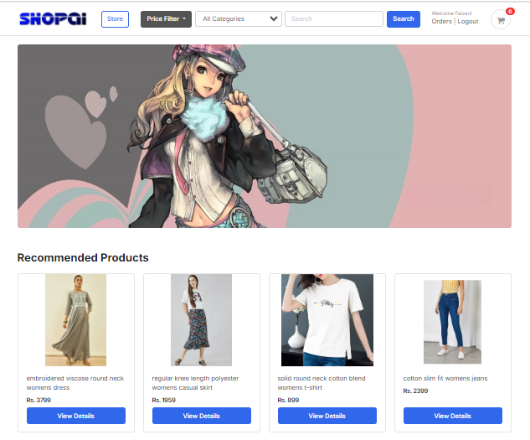
Home Page Interface:

Slide 24
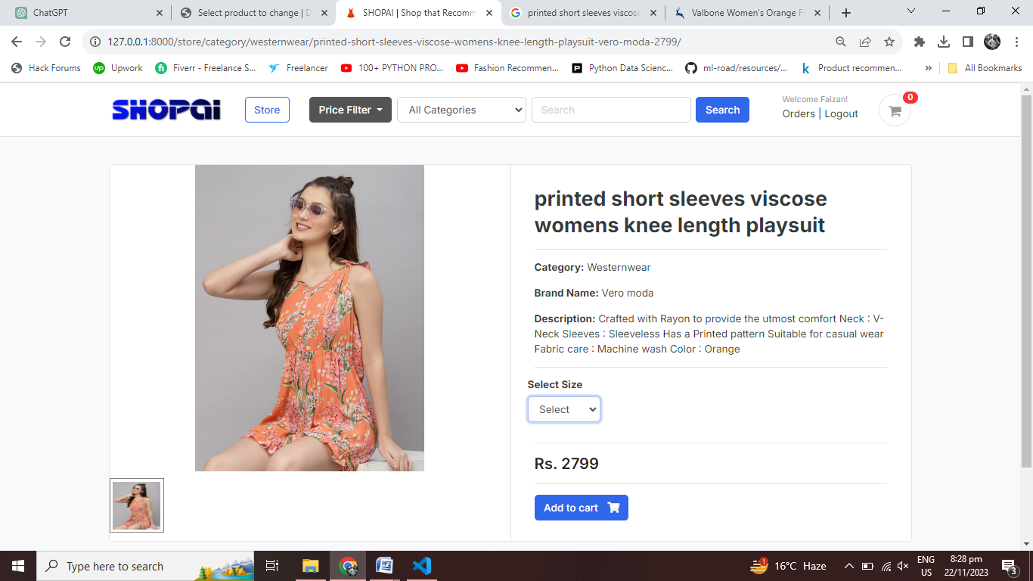
Product Detail Interface:

Slide 25
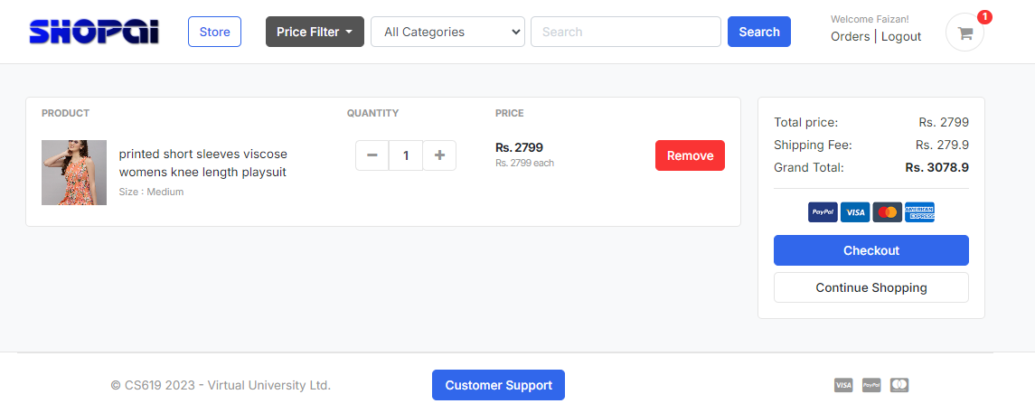
Logged-in User’s
Cart Page Interface:

Slide 26
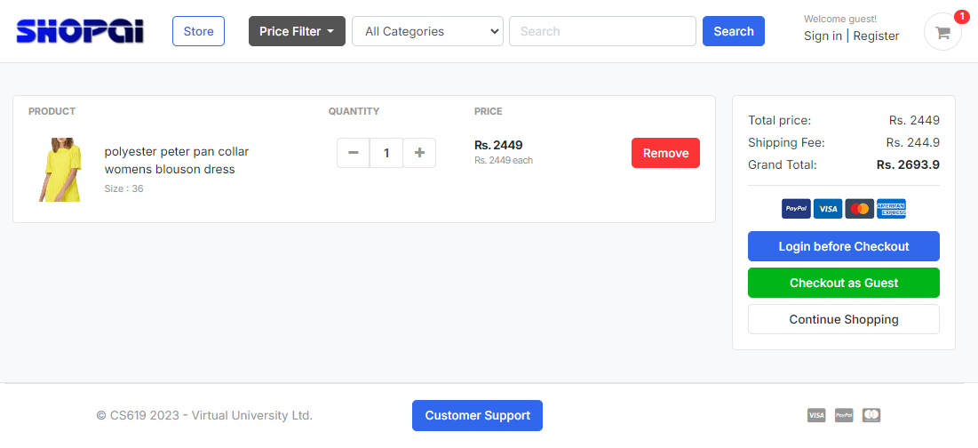
Guest User’s
Cart Page Interface:

Slide 27
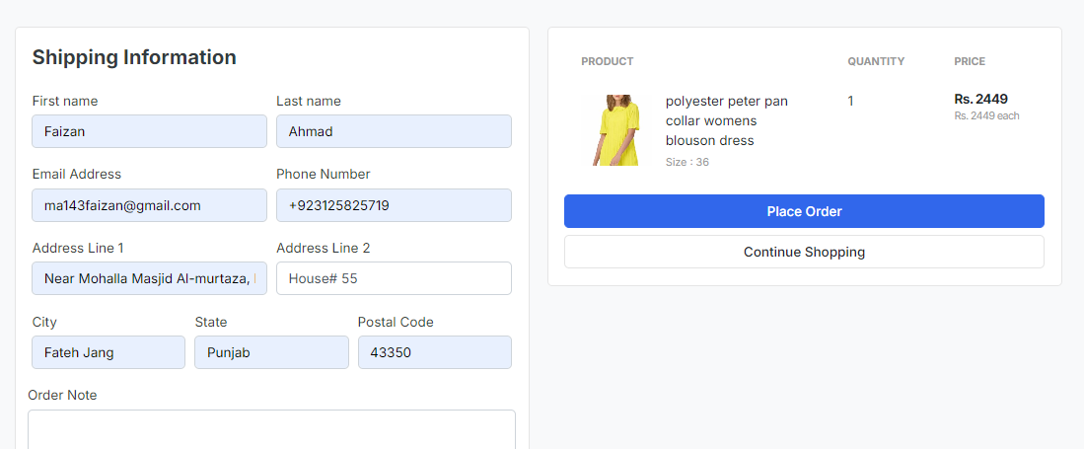
Shipping Info Page Interface:

Slide 28
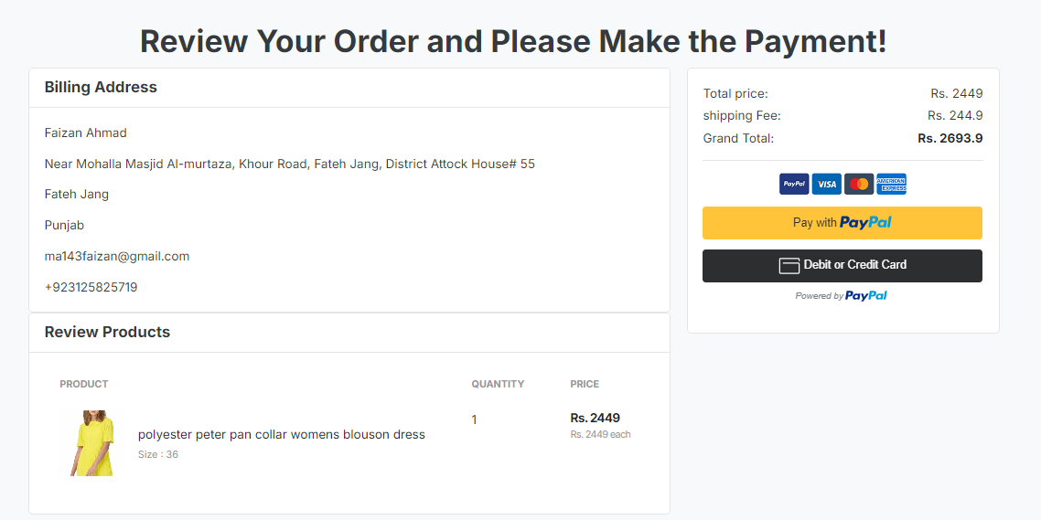
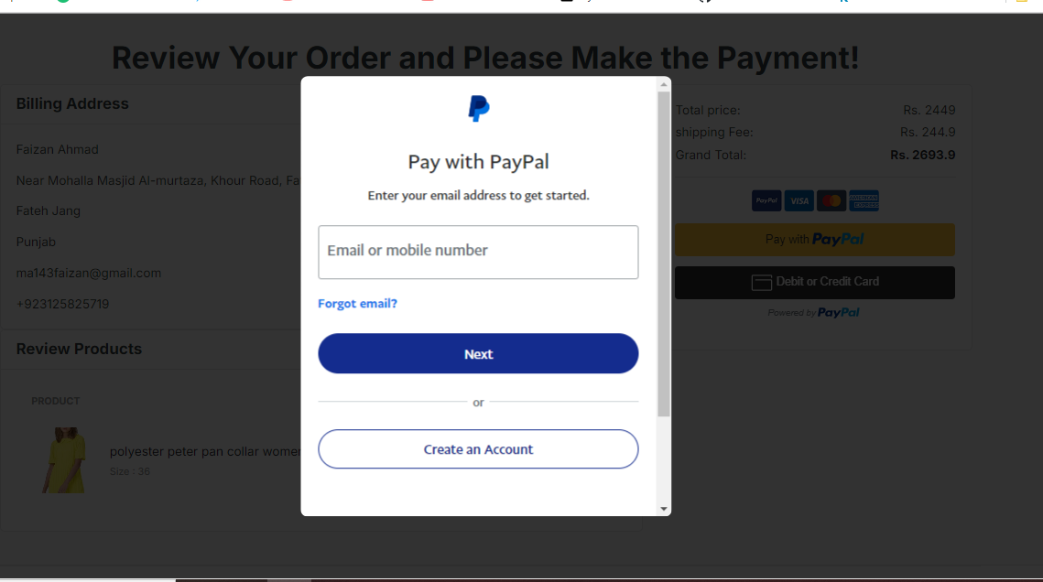
Payment Page Interface:

Slide 29
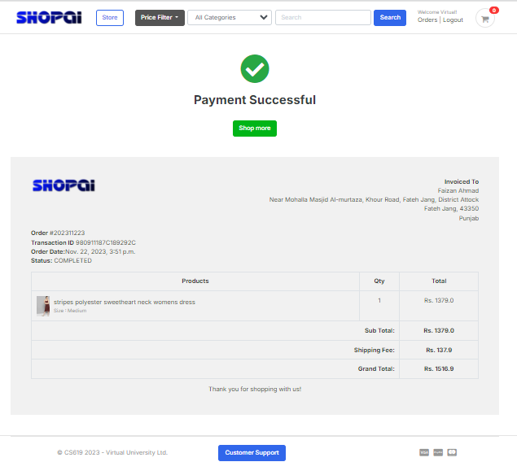
Payment Successful Interface:

Slide 30
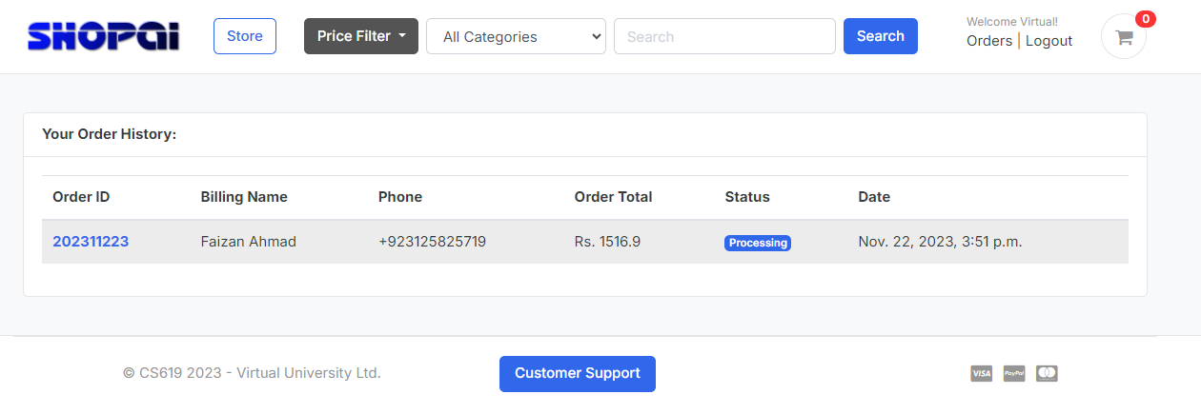
Logged-in User’s
Order History Interface:

Slide 31
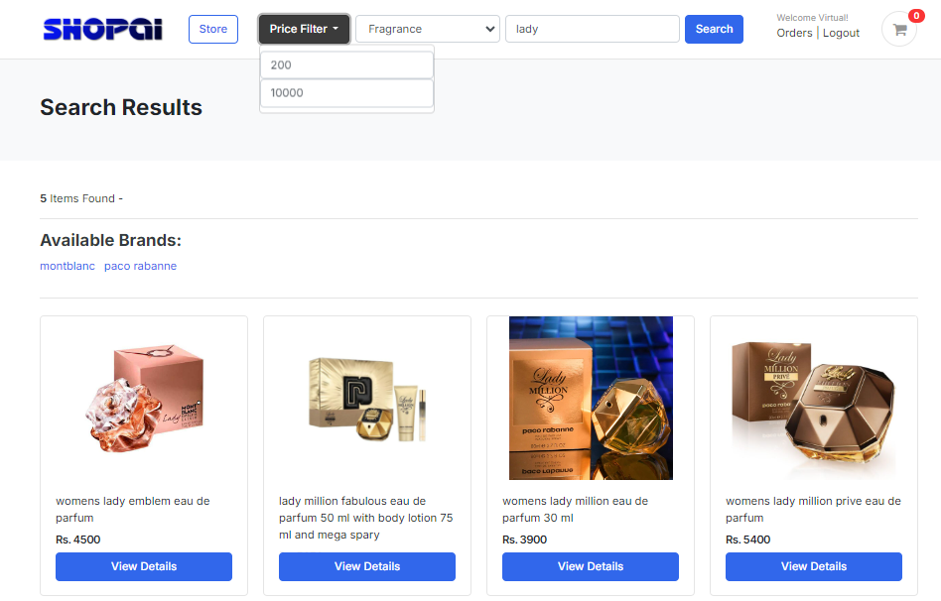
Search & Filtering Interface:

Slide 32
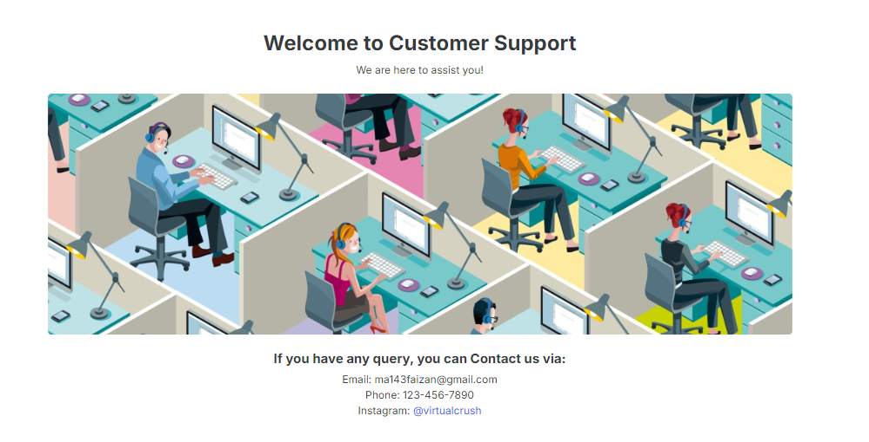
Customer Support Interface:

Slide 33
TOOLS:
Python (Django)
Visual Studio Code
Jupyter Notebook
Anaconda

